Slide 2
Follow Me:
Introduction to social media analysis in R
Maria Prokofivea, Saskia Freytag and Anna Quaglieri
R-Ladies/Victoria University (Australia)

Slide 3
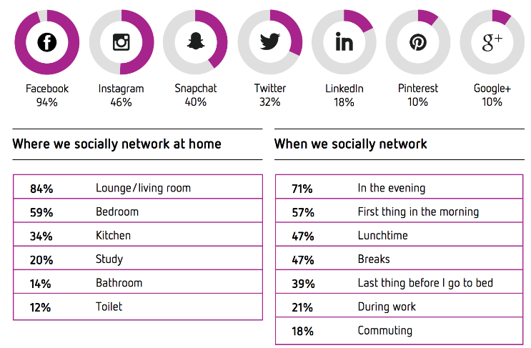
Social media
forms of electronic communication through which users create online communities to share information, ideas, personal messages, and other content (Merriam-Webster)
Social media census report 2017
Reasons for social media use:
catch up with family and friends (89%)
share photos or videos (57%)
watch videos (43%).

Slide 4
Social media analytics
gathering data from social media websites and
analyzing that data to make business decisions.
Key question: which social media platform? Which measurements? How to move on?
Examples: Who is your consumer? How to improve product/service?
What are uncovered needs/niches?

Slide 5
Social media analytics trends
Metrics: demise of “vanity” metrics (likes, dislikes)
Focus: from engagement to lowering costs and attracting talant
Decline of corporations and government trust, the rise of micro-influencers
Social commerce
Social listening: tracking conversations, identify recurring phrases, words or brands, identify uncovered demands and opportunities

Slide 6
Structure of the social media data
Graph API: "the global mapping of everybody and how they're related”, introduced by Facebook in May 2007,
Components:
nodes —individual objects (e.g. a User, a Photo, a Page, or a Comment)
used to get data about a specific object, accessed by a unique ID (e.g. official Facebook Page has the ID 20531316728)
edges — connections between a collection of objects and a single object (e.g. Photos on a Page, Comments on a Photo)
used to get collections of objects on a single object, accessed by node ID and the edge name
fields — data about an object (e.g. User's birthday, Page's name)
Used to get data about a single object or each object in a collection.

Slide 7
Graph API
Facebook
https://graph.facebook.com/facebook/picture?redirect=false
Instagram Graph API: to access data in large- and medium-sized Instagram Business Accounts https://developers.facebook.com/docs/instagram-api
For non-business accounts: https://www.instagram.com/developer/

Slide 8
Access token
an opaque string that identifies a user, app, or Page and can be used by the app to make API calls
includes information about when the token will expire and which app generated the token.
Examples of tokens (platform dependent):
User access token: most commonly used type of token
obtained via a login dialog and require a person to permit your app to obtain one.
App access token: obtained via a server-to-server call

Slide 9
OAuth 2.0 protocol
industry-standard protocol for authorization
allows entities (e.g. User or a Page) to authorize tokens
usually authorization is done through a web interface
once authorized, apps can use tokens to access specific information
The OAuth Bible

Slide 10
Facebook
https://developers.facebook.com/docs/facebook-login/
Birth: 2007. Wild Wild West. Vast data mining opportunities
2014: security measures to allow users decide what information they share with their apps.
April 2018: new app review process and more data protection. Severe cuts for data mining opportunities
May 2018: more data protection and security restrictions, enhanced developer app review and Graph API 3.0
July, 2, 2018: Facebook Login changed again. More protection, more security. Can we get any data from Facebook now? RIP https://developers.facebook.com/docs/facebook-login/changelog#2018-07-02

Slide 11
Instagram
https://www.instagram.com/developer/
Birth: October 2010
January 2018: Instagram Graph API announced
April 2018: severe restriction on API capabilities, closed and deprecrated major Instagram API endpoints.
older Instagram API is deprecated on July 31, 2018

Slide 12
Twitter
https://developer.twitter.com
Birth: 2006
April 2017, the Account Activity API is announced
GET READY: API major update August 16th

Slide 13
Social media - Predictive analytics

